Slide 1
GPU support for the Quark Container
2022/10/05
Hao Xu (hxu1@futurewei.com) , Yulin Sun (ysun3@futurewei.com)

Slide 2
Goals
Add GPU support to Quark container, which is a secure container platform that provides VM level isolation as well as high performance.
Explore GPU virtualization possibilities, based on the Quark container platform.

Slide 3
Current GPU support for container
NVIDIA docker runtime
It’s mainly a wrapper over low level container runtimes, i.e. runc, lxc and etc. And the Nvidia setup is done in a prestart hook.
Three major components and multiple source code repositories: https://github.com/NVIDIA/nvidia-docker https://github.com/NVIDIA/libnvidia-container https://github.com/NVIDIA/nvidia-container-runtime https://github.com/NVIDIA/nvidia-container-toolkit https://gitlab.com/nvidia/container-toolkit/container-toolkit

Slide 4
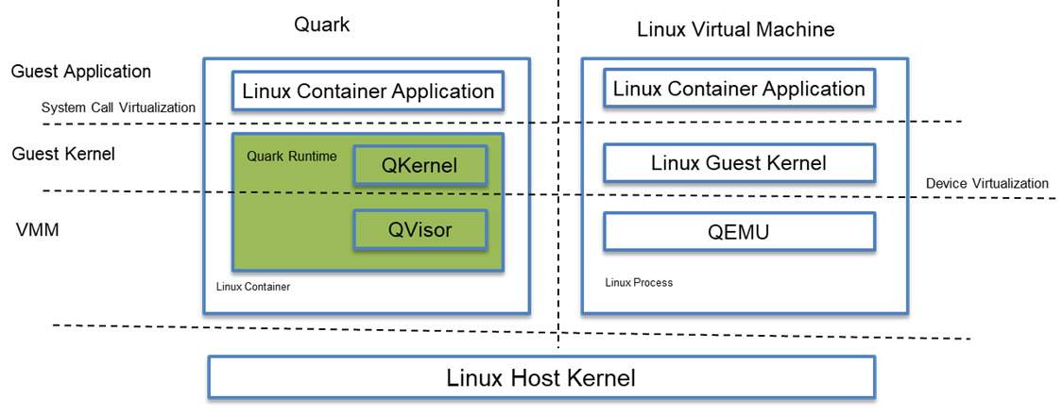
Quark container

Slide 5
How to add GPU support for Quark?
Option 1: Use NVIDIA docker runtime, and configure the low level container runtime to be quark, instead of runc.
Option 2: Don’t use NVIDIA docker runtime. Instead, use NVIDIA libnvidia-container and integrate it as a prestart hook in Quark container itself.
Either option should work.

Slide 6
Several issues already solved
NVIDIA prestart hook does not work with Quark out of the box. Some of the issues: A) The NVIDIA libraries won’t show up after setup. B) Various segmentation faults. C) The NVIDA libraries show up but with size 0.
NVIDIA make assumptions that only apply to runc, like the bundle location. The long parameter list the container runtime passes to libnvidia-container needs to be modified.
Nvidia container and Runc source codes greatly helped us pinpoint the issues.

Slide 7
Even bigger challenges
After solving the previous integration issues, we met with bigger challenges: the libraries simply doesn’t work.
Further investigation shows that it’s related to the implementation of ioctl and mmap.
Quark is a secure container, which has the additional memory protection provided by QKernel and QVisor. And the guest memory space and the host process memory space are separate.

Slide 8
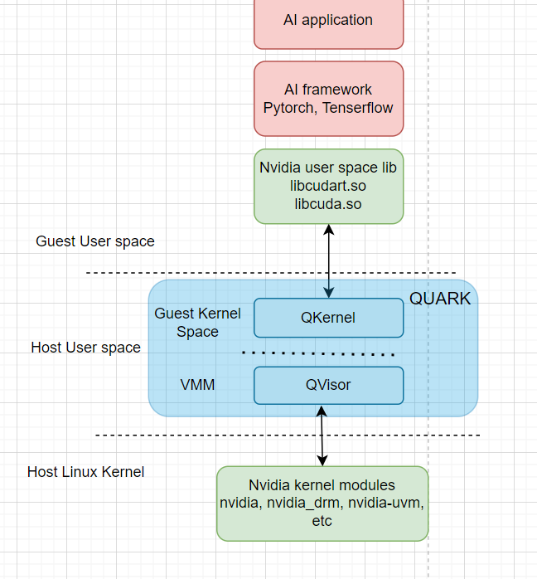
The core problem
The NVIDIA user space libraries are mounted into the guest memory space, while The NVIDIA kernel modules are in the host memory space.
Whenever a guest memory address is passed from the user space libraries to the kernel modules, the content of that address needs to be copied into where the host can access. And the address needs to be replaced with that host address.

Slide 9
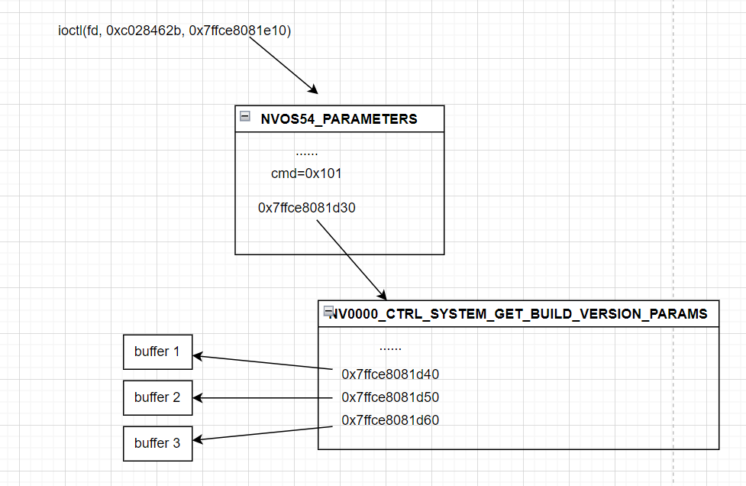
An example

Slide 10
Some thoughts and future direction
Nvidia recently open sourced their kernel modules and without this information, we wouldn’t know what structure the guest memory is pointing to.
What about mmap? Unified memory? MMIO and PCIe BARs? We need to think through all these aspects, perhaps.
Different approaches 1) Mount both user space libraries and kernel modules in the host. 2) API remoting.

Slide 11
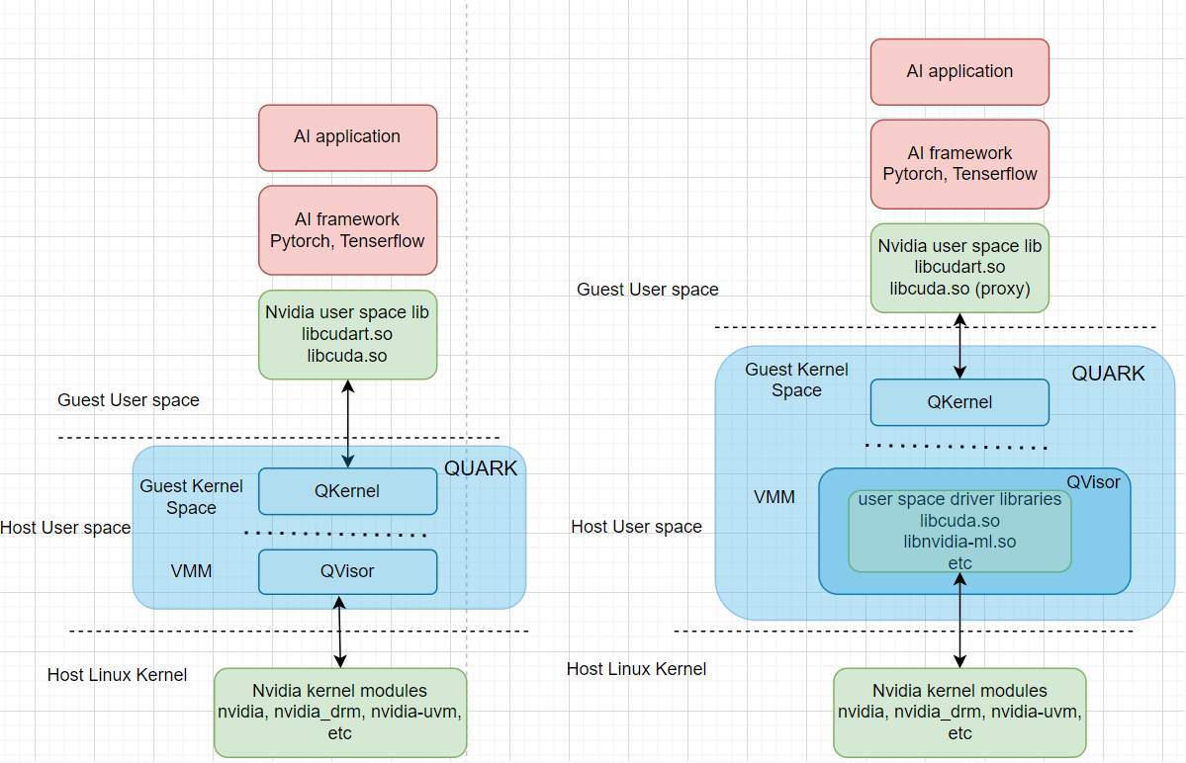
Method 1 vs 2

Slide 12
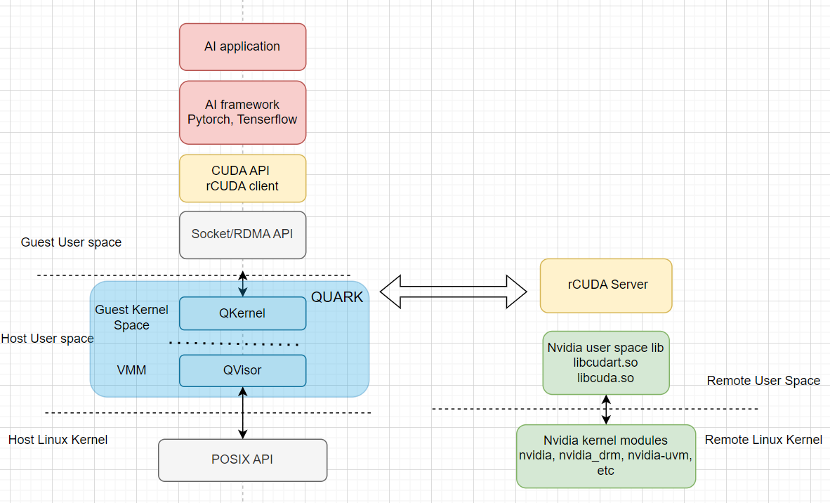
Method 3: rCUDA

